Slide 1
Android

Slide 2
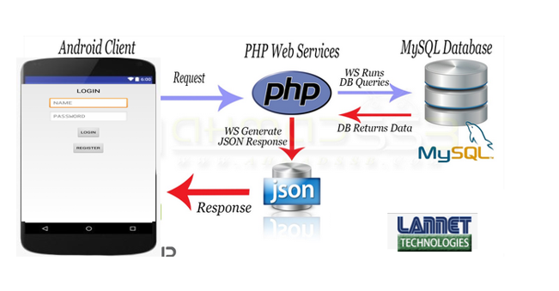
Android app flow ( request & response)
Android apps using android studio software
Java
Login.java
Register.java
Home.java
Xml ( layout)
Login.xml
Register.xml
Home.xml
Php
Init.php
To setup connection to database
Login.php
To send user information and retrieve from database for compare purposes
Register.php
To send and store user information to database
Database MySQL
https://www.000webhost.com
Table
User_info
For login and register
Water_level_detection
For data retrieve

Slide 3
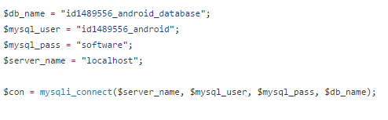

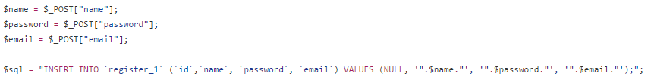
Php file
Init.php
Login.php
Register.php

Slide 4
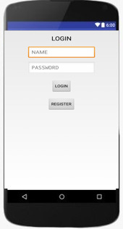
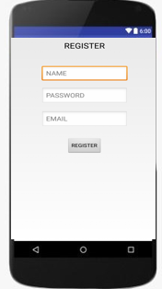
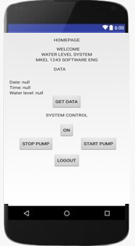
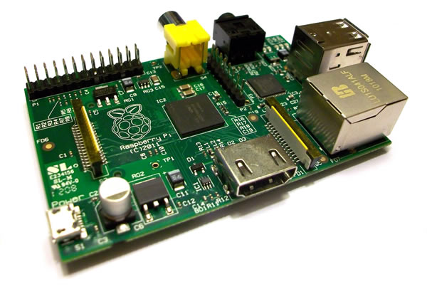
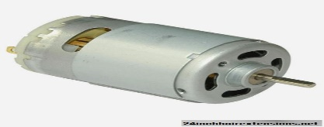
Android app user interface
System Control
ON
START PUMP
STOP PUMP

